Slide 1
Introduction to Classification Problems and Logistic Regression
ENGR 96A: Python and Machine Learning

Slide 2
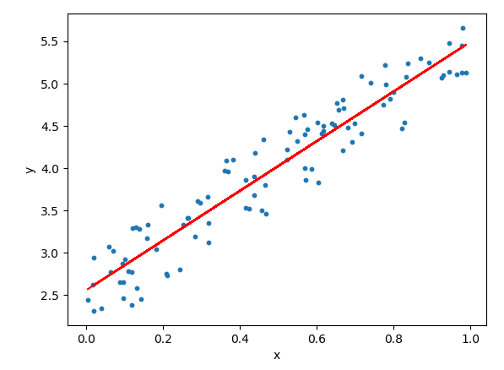
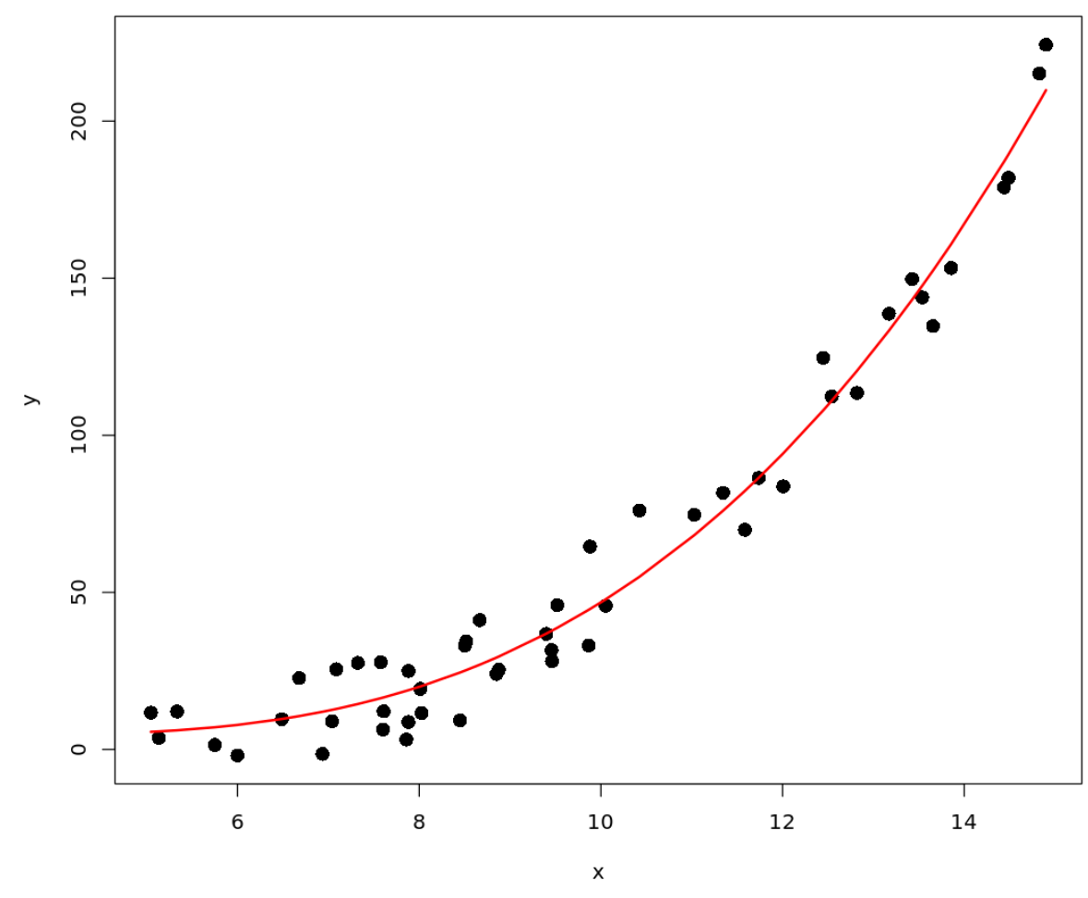
Review: Regression Problems
Last week we learned about regression: Predicting a continuous quantity given some data
After fitting our model, we can input new data into our function to get a predicted value based on the trend of the data that we have
This can be used to fit linear and polynomial trending data, in many different dimensions

Slide 3
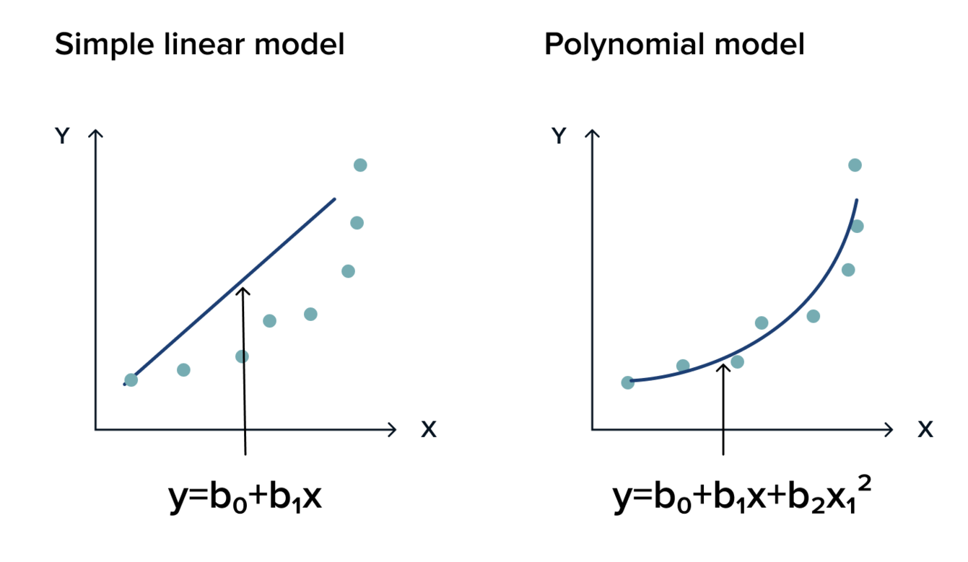
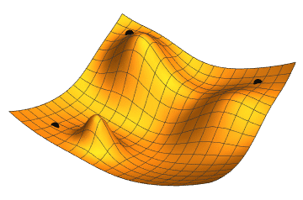
Review: gradient descent
Pick a model type
Determine hyperparameters
Set initial model parameters
Define loss function
Calculate loss from model parameters
Calculate gradient of loss with respect to parameters
Change parameters slightly according to gradient
Repeat from step 4 until loss is small
Store final parameters
Terminology note:
Parameters are the weights being trained
Hyperparameters are decided before training a model

Slide 4
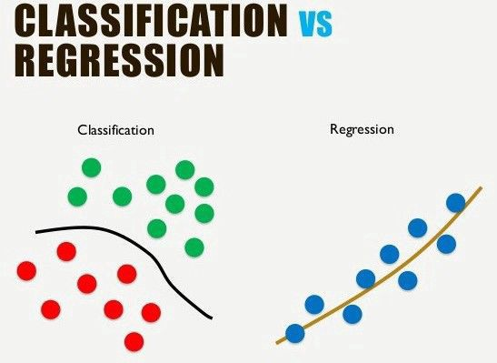
Classification Problems
Another common type of task we can use machine learning for is classification
Consists of predicting a label based on our set of data
Instead of predicting a continuous quantity like in regression, we predict the group that a datapoint belongs to

Slide 5

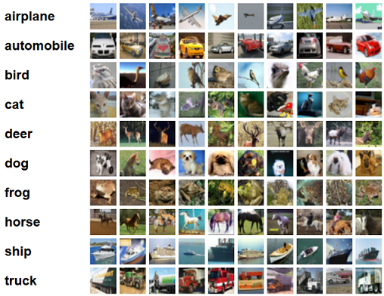
Examples of Classification Problems
One popular machine learning dataset called CIFAR-10 contains 60,000 images of 10 different classifications
Multi-class Classification Examples:
ImageNet
MNIST
If we have a dataset of pictures of dogs and cats, we can try to separate this set into these two groups
This is called a binary classification problem
In the field of Engineering, you might be asked in the future to….
Tell certain groups of people are stressed or not
Test if a device is malfunctioning

Slide 6

Intuition - Classification
:) Toy Example
Let’s say four students were preparing for a test.
 | X1: Study Time (hours) | X2: Nervousness (1-10) | Y: Score (0-100)
Alice | 8 | 4 | 90
Bob | 3 | 9 | 55
Charlie | 9 | 6.5 | 85
Diana | 7 | 5 | ?
 | X1: Study Time (hours) | X2: Nervousness (1-10) | Y: Pass or Fail (1 or 0)
Alice | 8 | 4 | 1
Bob | 3 | 9 | 0
Charlie | 9 | 6.5 | 1
Diana | 7 | 5 | ?
With Linear Regression, Y = 3.57 * X1 - 3.43 * X2 + 75.14
Plug in Diana’s data, Y_diana = 3.57 * 7 - 3.43 * 5 + 75.14 = 82.98
With Linear Regression, Y = 0.143 * X1 - 0.057 * X2 + 0.086
Plug in Diana’s data, Y_diana = 0.143 * 7 - 0.057 * 5 + 0.086 = 0.802

Slide 7

Intuition - Classification
:) Toy Example
 | X1: Study Time (hours) | X2: Nervousness (1-10) | Y: Exam score (out of 1)
Alice | 8 | 4 | 0.90
Bob | 3 | 9 | 0.55
Charlie | 9 | 6.5 | 0.85
Diana | 7 | 5 | 0.83
Bruce | 20 | 5 | ?
With Linear Regression, Y = 0.143 * X1 - 0.057 * X2 + 0.086
Plug in Diana’s data, Y_diana = 0.143 * 20 - 0.057 * 5 + 0.086 = 2.661 ??????

Slide 8
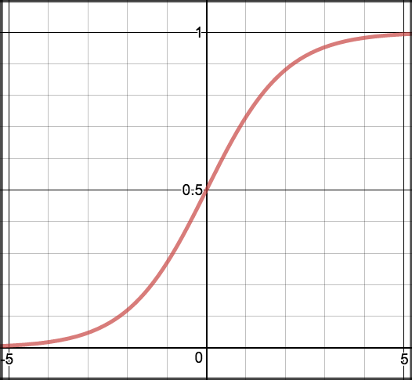
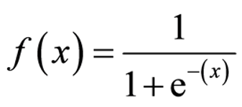
Sigmoid Function
In order to map predicted values to probabilities, we use the Sigmoid function. This function maps any real value into another value between 0 and 1. In machine learning, we use sigmoid to map predictions to probabilities.
-∞
0
+∞
0
½
1

Slide 9
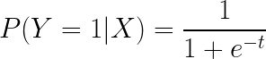
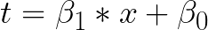
Logistic Regression
Using the sigmoid function, we can model the probability that a datapoint corresponds to a specific class:
where:
As you can see, this is very similar to linear regression, except for the inclusion of the sigmoid function, which transforms the y-axis into the range [0,1]

Slide 10
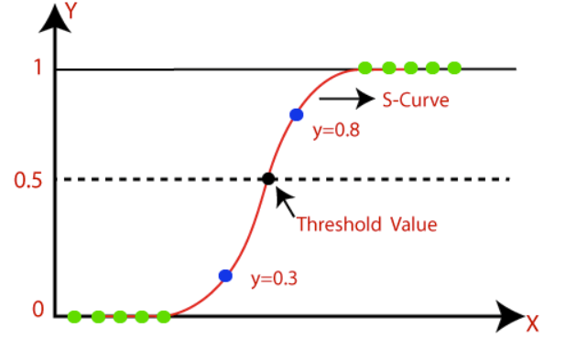
Logistic Regression
After applying the sigmoid function, we classify a point into one of the two classes based on a threshold value (usually y=0.5)
If the output is above this threshold, we classify the point into the 1 class
Otherwise, we classify it into the 0 class

Slide 11
Summary
Types of Machine Learning Problems:
Regression - Predicting continuous data
Classification - Predicting a label
Classification problems can take a number of forms, having anywhere from two to infinite labels depending on the dataset and our objective
One common machine learning classification model is logistic regression
It uses the sigmoid function to map predicted values to probabilities, which can be used to classify data points into one of two or more groups

Slide 12
Other Important Machine Learning Topics
ENGR 96A: Python and Machine Learning

Slide 13
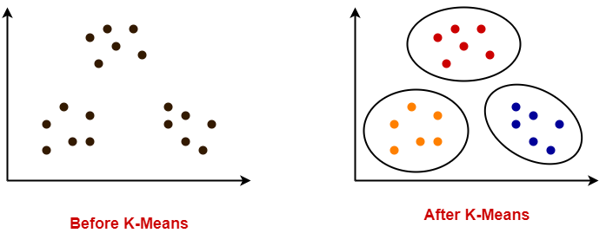
Types of Machine Learning Problems
Learning types
Supervised learning - labels
Unsupervised learning - unlabelled
Output types
Classification - discrete
Multiclass classification
Binary classification
Regression - continuous

Slide 14
Terminology
Parameters - the numbers you are training
Hyperparameters - choices you make before you begin training
How large are your gradient descent steps?
What type of model are you using?
How long are you training for?
What is an acceptable loss?
Epoch
Iteration
Learning rate

Slide 15
Dividing your data set
To train a machine learning algorithm you will be given some data to work with
It is a good idea to split this data into separate datasets
Training data - the data you will be using to train your model
Testing data - the data you will be using to show the accuracy of your model
Validation data - data you will use to tune hyperparameters
Tricky distinction from testing data: testing data is not supposed to be used to make a choice
K-fold cross validation
Splitting your data into k groups and using one group for validation

Slide 16
Types of gradient descent
Types of gradient descent
Batch gradient descent - what we have been discussing
Stochastic gradient descent - only training on one point at a time
Mini-batch / Semi-Stochastic gradient descent - training on a portion of the whole batch
Gradient descent algorithms
Traditional
Momentum
Nesterov accelerated gradient descent
Adagrad
Adam
Notes:
https://ruder.io/optimizing-gradient-descent/index.html#nesterovacceleratedgradient

Slide 17

Underfitting / Overfitting
Be careful when training your model not to overfit or underfit
Right now it is easy to visualize overfitting and underfitting, next lecture it probably won’t be this easy
This is a reason why validation and test sets are so important

